Slide 1
Google Fit
Coaching you to a healthier and more active lifeTM
Kyle Aagard
Subham Dandotiya
Yuxuan Gan
Ashley Goldstein

Slide 2
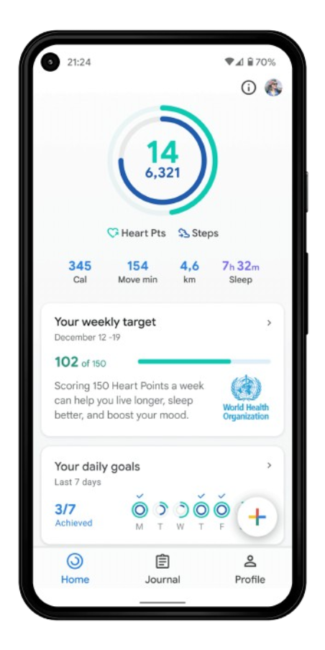

All Encompassing Tracker
Daily goals made in collaboration with the AHA
Month of October
20 min activity
Walk 10,000 steps
Drink 64 oz water
M T W T F S S
M T W T F S S
M T W T F S S
Whatever your preferred brand, Google Fit can sync all devices and apps into one place to give a macro view of your health.
Google Fit can use your phone’s pedometer or any other device you wear to track steps, without duplicating records.
Log directly or sync with popular nutrition trackers like MyFitnessPal.
Notes:
Hi all, I’m Ashley and I’m gonna introduce our database on Google Fit. There are dozens of specific apps available for a person to visualize their health-related habits; some focus on fitness, some on nutrition and weight-loss, some on journaling. Google fit is unique in that it aggregates all of this information into a central place. It utilizes an open ecosystem database, meaning it takes data from many different sources and outputs an integrated API in order to create more value for the user. Put simply, whatever your preferred brand of fitness, nutrition, or health tracking, Google Fit can assemble it into one app to give you a macro view of your habits. Say you track a walk through the app, but are also wearing an apple watch. Google can recognize the inputs have identical timestamps and will only record one source in order to avoid duplication.
As a default, daily goals are made in collaboration with the American Heart Association, giving users recommended milestones of 10,000 steps per day and 150 minutes of moderate activity per week. However, these can be modified by users to fit their personal ambitions.

Slide 3


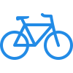


Scope
Profile Management
Activity Tracking
Health Metrics
Goal Setting
Notifications
Notes:
The scope of our project covered five domains. Profile management imports a user’s demographics from their google account, making registration painless. Activity Tracking will retrieve and store data from a device or third party app related to user fitness such as hiking, cycling, running, and other workouts. Health Metrics is where a user can record or import data not related to fitness, but still important in their health journey. Goal Setting is where users can adjust their step or heart point goals from the recommended AHA number. And finally, we’ll be using notifications to keep a user up to date on their progress. I’m going to defer to Subham now so he can explain the requirements to encompass this scope.

Slide 4

Requirements
Requirement | Description | Tables Needed | Priority
Profile Management | Import user information such as name, gender, date of birth, and unique identifiers from google account. Display step and heart point goals | Profile Device Goal | High
Activity Tracking | Store data related to user activities such as steps, cycling, running, and other fitness workouts | Activity Device | High
Health Metrics | Store detailed body metrics like vitals, cycle, height, weight, and BMI | Health Log Vitals Sleep Cycle Body Measurement Nutrition Log | High
Goal Setting | Set step and heart point goals according to AHA guidelines, adjustable by the user. Allow user to set up detailed fitness goals | Profile Health Log | Medium
Recommendation | To outline post-workout feedback and future workout suggestions | Health Log Coaching Plan Goals | Low
Coaching Plan | Create a timeline of workouts or fitness goals to meet for a user to reach a desired goal | Health Log Recommendations | Medium
Notifications | Send notifications to a user’s device regarding their fitness journey | Recommendations Device Coaching Plan | Medium
Final List of Tables: Profile
Device
Health Log
Sleep
Cycle
Vital
Body Measurement
Nutrition
Activity
Notification
Goal
Coaching Plan
Recommendation
Notes:
"Hello everyone. My name is Subham. I'll walk you through the core requirements for managing and tracking fitness data."
To manage the user information like their name, age we are extracting all the information from their Google Account.
We are also keeping a track of user’s activity like running, swimming, yoga etc. For each activity we are storing information like calorie expenditure, distance covered during the activity.
We are also maintaining their Health Metrics like height, weight, BMI etc.
All of that information gathered will be used to send out notifications to the user.
The recommendation and coaching plan requirements are part of our expansion on Google Fit’s current platform, Kyle will be talking about that in detail, first i want to go over our physical model with you.

Slide 5
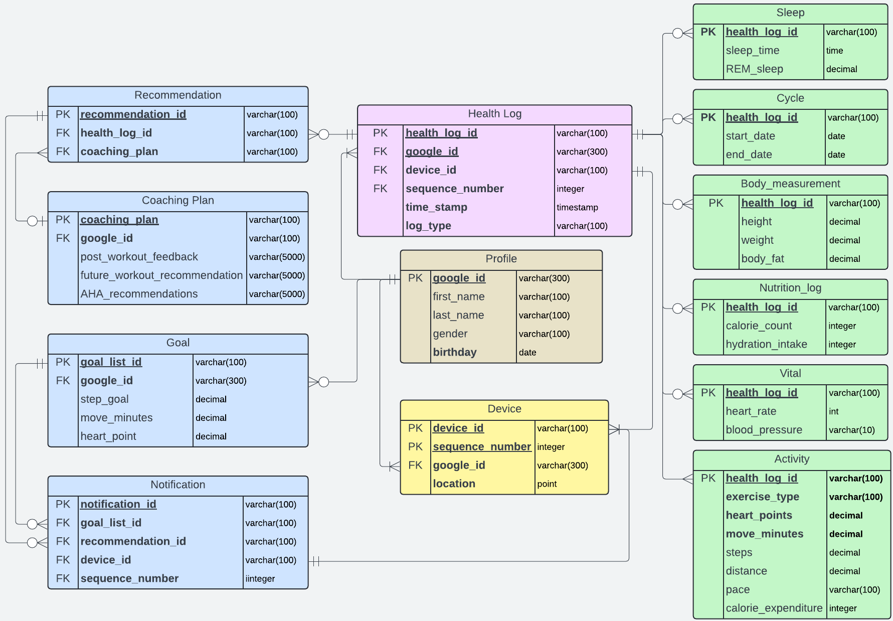
Physical Model
Notes:
In physical model, The health log is the central table. All incoming data from a user’s device or third party app will be available in Health Log table which is then categorized into the subtypes like nutrition, sleep and activities likes running, swimming, yoga. This simple approach to categorize data into subtype and supertype allows database to remain logical, coherent and consistent to our requirements. Recommendation and Coaching Plan Tables are our new enhancement. At this point I’ll handover it over to Kyle to explain further.

Slide 6
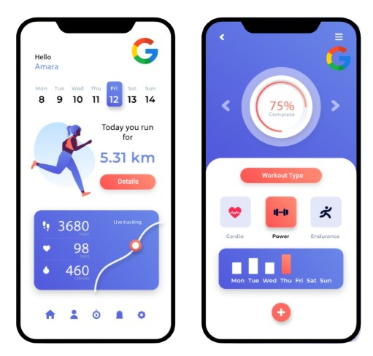
Looking Forward
Increase engagement by creating unique coaching plans based
on each user and their workouts
Workout Recommendations – how the user can
improve their fitness and achieve goals.
Post Workout Feedback –specific comments based on the
exercise that was just completed
Notes:
By creating the two new entities of Recommendation and Coaching Plan the goals for Google Fit are:
-Become a more active partner with the user in obtaining their fitness goals
-This should result in an increase how much a user interacts with the application on a daily basis
-Make Google Fit more competitive with other fitness tracking applications such as Garmin Connect.
This will be accomplished using two main tools.
-Workout recommendations will help a user plan out their future workouts based on what they want to accomplish. This could range from someone wanting to walk a few days a week or someone else might want to improve their gains in the weight room or training for a marathon. A runner might be told to do some sprints, a cyclist to incorporate more hills.
After the user completes their workout, the Post Workout feedback tool will tell them how it went and what progress they have made with achieving their goals.
Let’s look at an example.

Slide 7
5K Coaching Plan
Month of October
Running Workout Calendar
M T W T F S S
Aim to improve your run pace with several different types of workouts.
Red indicates endurance runs, purple indicates hill sprints, blue indicates pace runs.
Be sure to read over the workouts thoroughly before starting!
Notes:
Here is an example of what the plan for one month of training for a 5K might look like. The user is given suggestions for different types of running workouts and the days to do them. They are also given tips for how to succeed in getting the most out of their workout.

Slide 8

5K Coaching Plan Feedback
Month of October
Running Workout Calendar
M T W T F S S
Way to go! You’ve complete over half your plan. You’re on track to improve your 5k pace by Oct 31.
Make sure you’re giving all your effort on the hill sprints, these workouts will help you keep your pace over varied terrain.
Nice work keeping your new pace on the long runs!
Notes:
This shows a runner who is halfway through their training plan. They are given encouragement when they achieve a minor goal, told if they are on track achieve their end goal and told if maybe they need to change something up to improve their results
This all meant create a more involved and active partnership with Google Fit where the user will come to rely on it to achieve their goals.
I will now turn this over to.

Slide 9
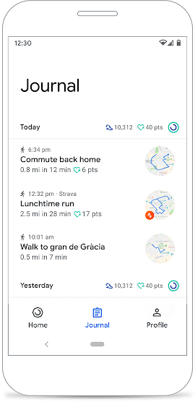
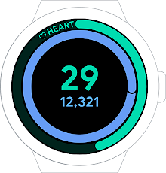
Focus On Enhancing Features
Coaching Plan
Personalized Fitness Journey
Recommendation System
Activity Goals To Improve Health

Slide 10
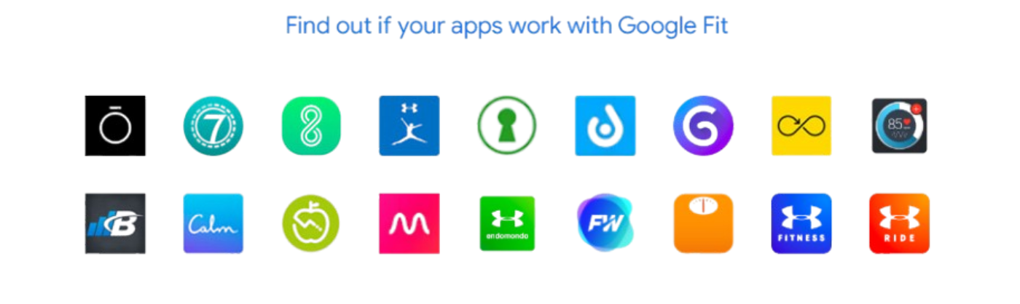
Extension Features
Mental Wellness Integration
Social Features
Advanced Analytics
Notes:
Extension features will utilize personal data, such as *mental wellness tracking*, which will monitor heart rate variability for stress analysis, and a *social component*, enabling users to share activities and motivate each other. These future enhancements will ensure that Google Fit remains the best option in digital health. The data collected will be able to play a role in advanced analytics. Google Fit works with many apps and provides essential data that benefits users. Today, Google Fit works with over 50 healthy living apps and keeps growing.

Slide 11

Get Fit.
Questions?
Notes:
Thanks for your patience to be here. Are there any questions for our project?

Slide 12
References
Google Developer Team. “Google Fit Guide” https://developers.google.com/fit/overview. Retrieved Sept 10, 2024.
Google. Google Fit overview https://www.google.com/fit/ Retrieved Aug 31, 2024.
Google Safety Center: https://safety.google/intl/en_us/security-privacy/ Retrieved Oct 19, 2024
Ogundiran, Samuel. "Google Fit." LinkedIn, https://www.linkedin.com/pulse/googlefit-samuel-ogundiran/. Retrieved Oct 12 2024.
Dynatrace. "What Is an Open Ecosystem?" Dynatrace, 16 Jan. 2023, https://www.dynatrace.com/news/blog/what-is-an-open-ecosystem/. Retrieved Oct 8 2024.

